Slide 1
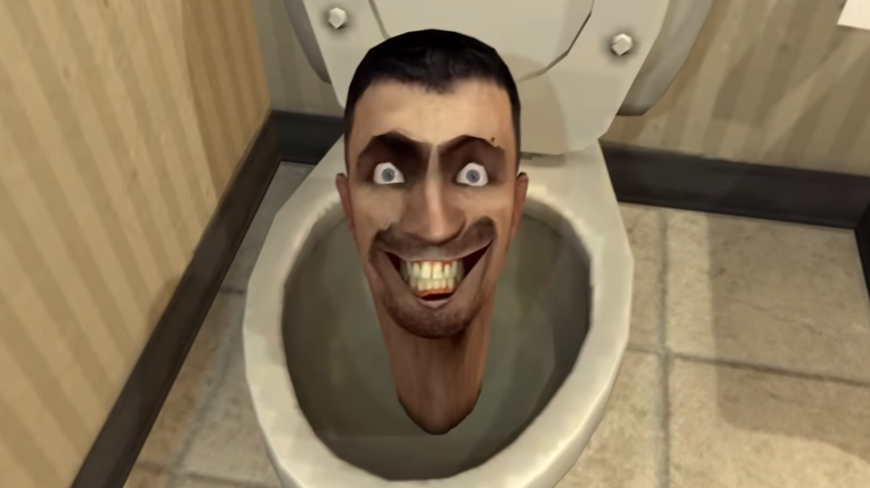
SILAS JAVIER’S SECRET SANTA LIST

Slide 2
XBOX CONTROLLER
All mine are broke and its between 25-50

Slide 3
New airpod case
Mine is 2 years old and I need something new

Slide 4
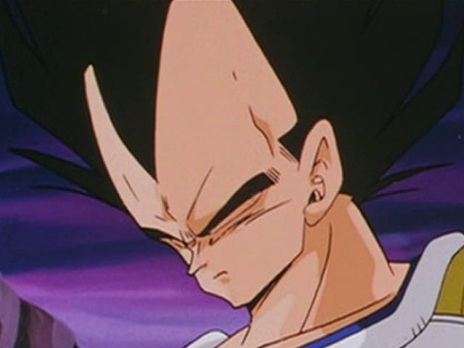
Funko pops
I don’t care what the funko is but I want one cause they fire frfr

Slide 5
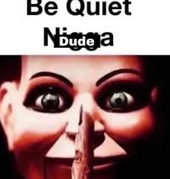
Roblox gift card
I need robux cause a fella is broke

Slide 6
cologne
I need a new scent that smels good

